Slide 1
Modelling SSC week 2
Cancer modelling I
Dr Richard Norris & Arran Pack
Notes:
<number>

Slide 2
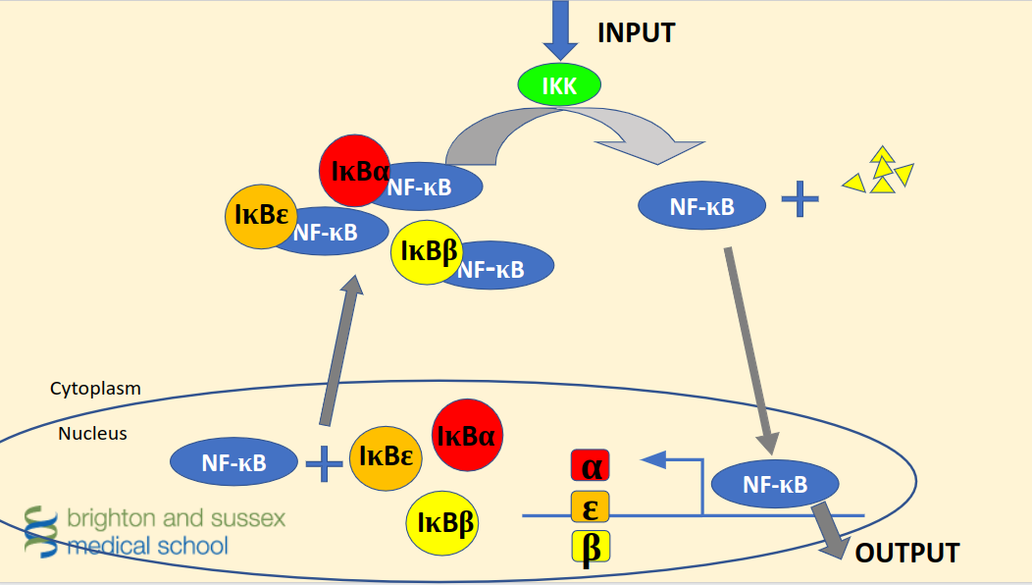
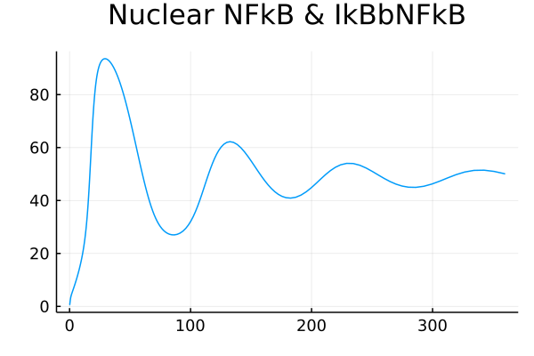
Recap from last week
Hoffman et al. 2002
Notes:
Above is a healthy response to stimulation with
Why does it want to oscillate?
<number>

Slide 3
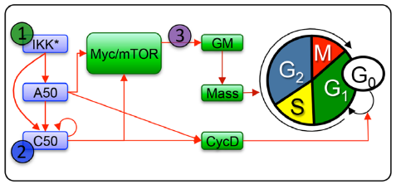
Cell cycle and upstream regulation by NF-𝜿B
Signalling via NF-κB regulates downstream processes including passage through the cell cycle.
Shokhirev et al, MSB, 2015
Notes:
Highlight previous work to develop models of cell cycle and how this relates to NF-𝜿B model

Slide 4
Cancer-causing mutations
Cells become cancerous following an accumulation of mutations that disrupt the control of cell proliferation.
The challenge for medical researchers is to identify which mutations are responsible for different types of cancer.
Some types of cancer are associated with specific mutational signatures, while mutations in some genes are associated with multiple cancer types. For example, Myc, a transcription factor that is involved in regulating several cellular processes is overexpressed in up to 70% of human cancers (Gurel et al., 2008; Palaskas et al., 2011).
Notes:
Set the scene

Slide 5
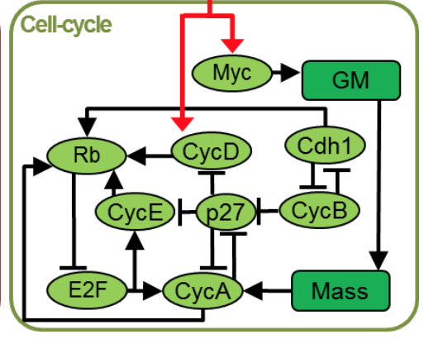
Why use systems biology?
Research in biology has historically used a reductionist approach, but with huge datasets available today we can build models enabling us to take an holistic approach to studying complex systems.
This allows us to model the effect of mutations on whole systems and potentially find new avenues for treatment.
Conradie et al, FEBS Journal, 2010
Notes:
<number>

Slide 6
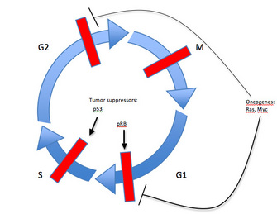
Control and deregulation of cell cycle phase transitions
Deregulation of proteins that regulate cell division events can lead to aberrant progression from one cell cycle stage to the next.
G1 and G2 are growth phases and DNA synthesis happens in S phase
p53
Tumour suppressors
pRB
Oncogenes
Ras, Myc
Chow et al, Nature Education, 2010
Notes:
Discuss cell cycle phases and control of transitions

Slide 7
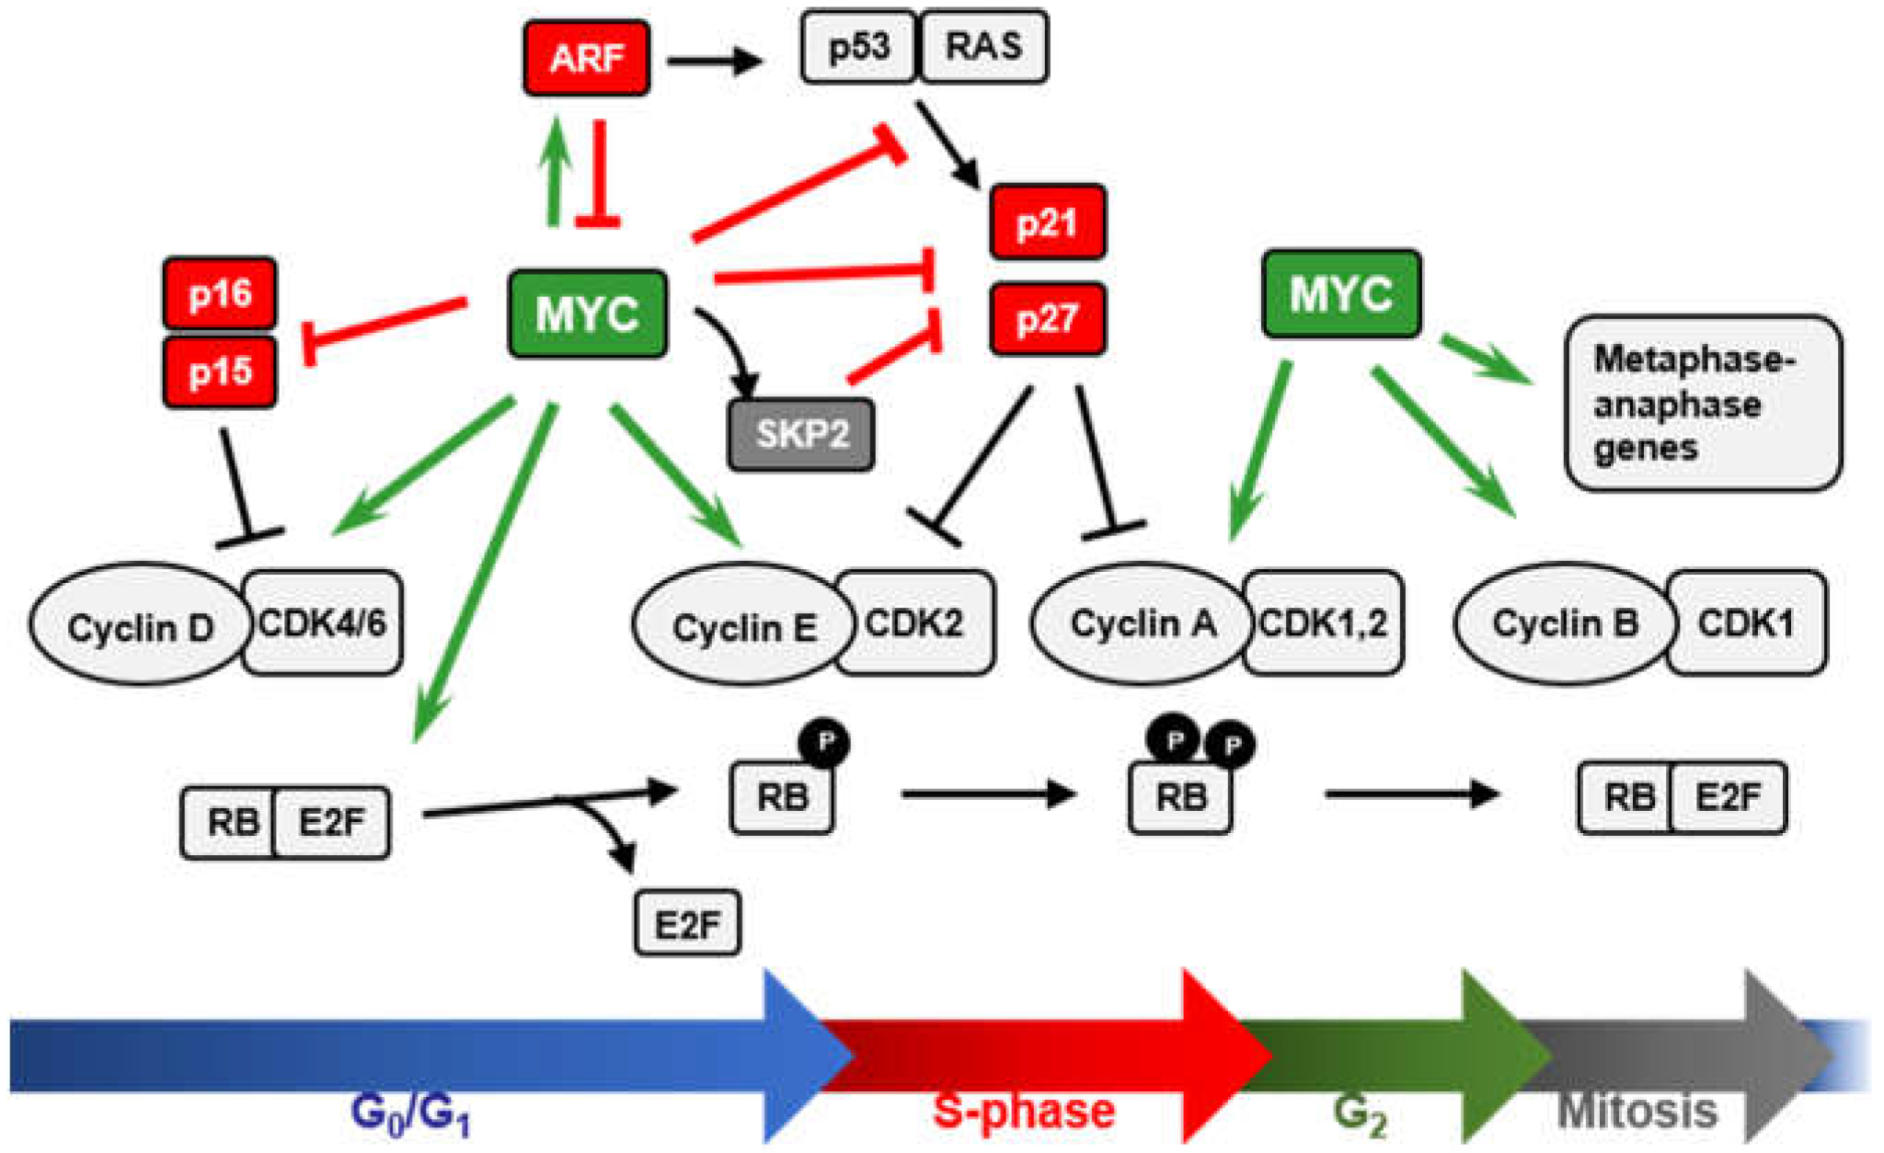
Plotting the output of the cell cycle model
Progress through the cell cycle is characterised by levels of specific cell cycle regulators.
Cyclin E/cdk2 drives initiation of DNA replication
Cyclin A regulates progression through S phase and the timing of progression into mitosis
Cyclin B/cdk1 is required for entry into and progression through mitosis
Cdh1 negatively regulates DNA replication and cell proliferation through the targeted ubiquitination and subsequent degradation of multiple targets, to establish and maintain the G0/G1 state Jeffrey R. Skaar and Michele Pagano, Nat Cell Biol 2009

Slide 8
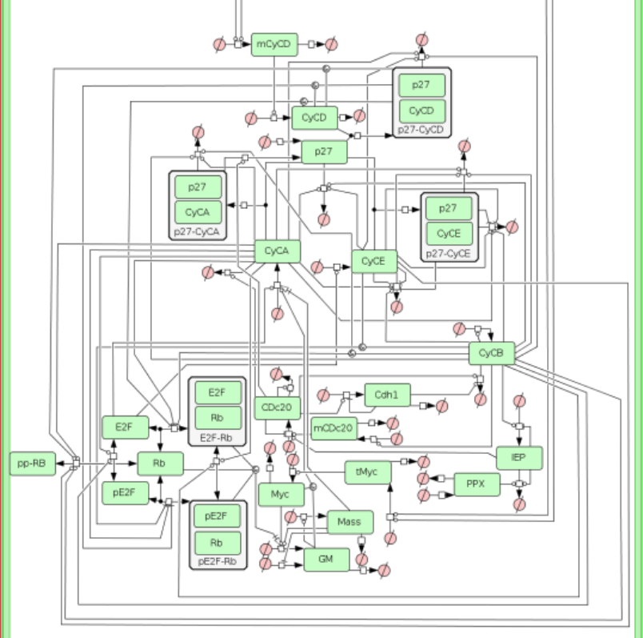
Notes:
<number>

Slide 9
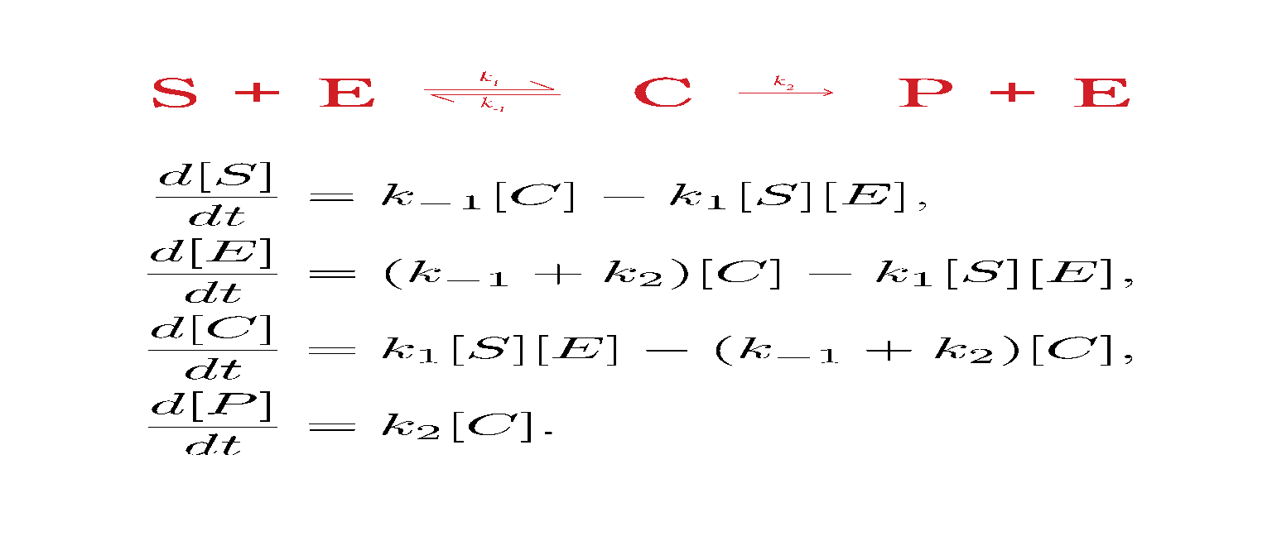
Models consist of Ordinary Differential Equations
Notes:
<number>

Slide 10
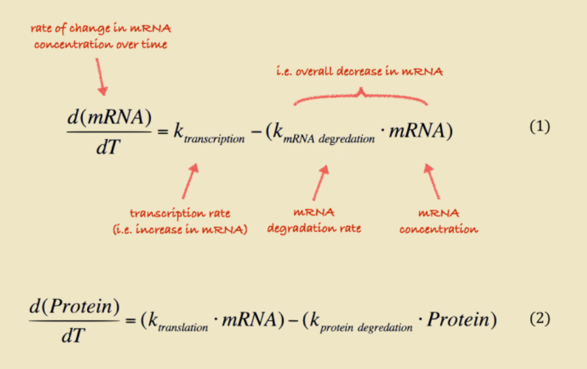
Notes:
<number>

Slide 11
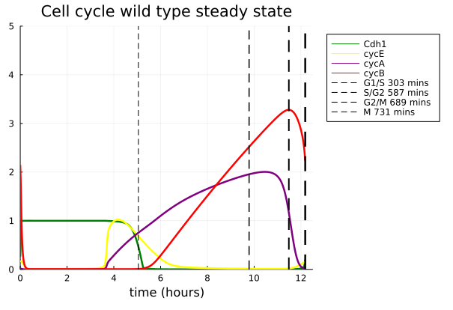
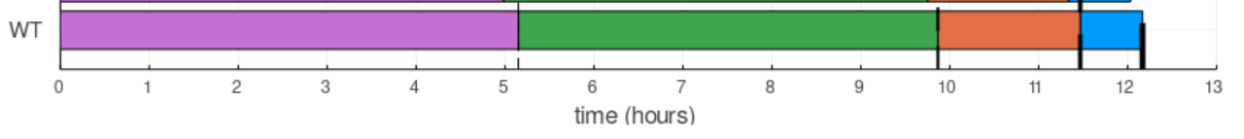
Plotting the output of the model
Time (hours)
Notes:
<number>

Slide 12
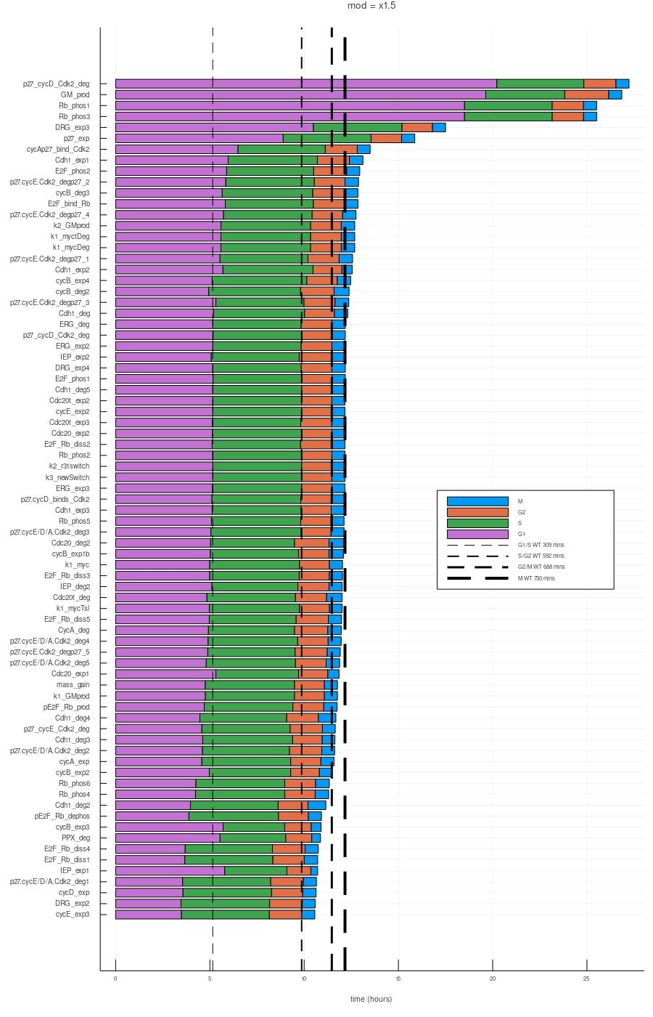
Cell cycle transition timing derived from simulation of mutations
Here we can see the effect of changing parameters in the cell cycle model on the overall length of the cell cycle and the timing of phase transitions.
Parameters
5 10 15 20 25
Time (hours)

Slide 13
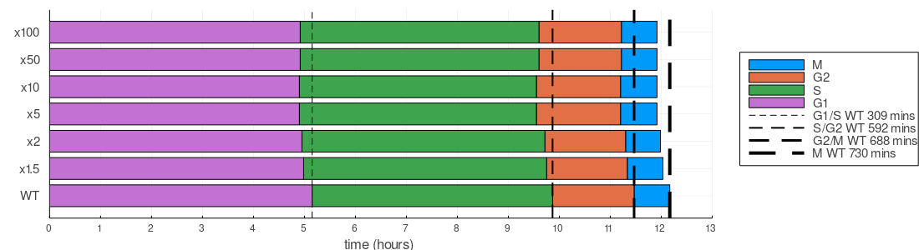
Mutation example: overexpression of Myc
The model predicts that overexpression of Myc shortens the cell cycle, but this effect is limited.
Notes:
Point out variation in transition times

Slide 14
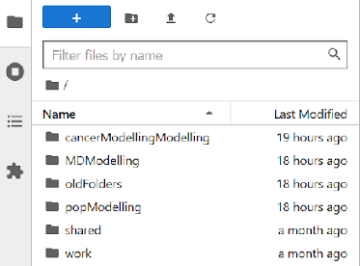
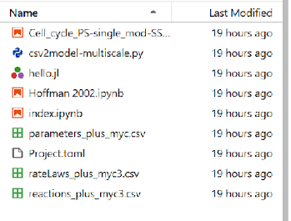
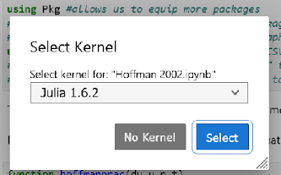
In a browser, go to: 139.184.170.218:9001
Log In with your unique login
>cancerModellingModelling
>Hoffman 2002.ipynb
>Julia 1.6.2

Slide 15
Now let’s simulate other mutations…
Instructions:
Here is a list of parameters to modify. Modifying these parameters enables simulation of mutations that change the expression level of associated genes.
k1_10, k1_12, k1_13, k1_14, k1_16, k1_18, k1_27, k1_28, k1_2aa, k1_30,
k1_31, k1_32, k1_34, k1_3a, k1_6a, k1_8a, k1_J4
You can see which genes correspond to each parameter using the paramNames dictionary.
Edit the parameter name as highlighted, run the simulation and plot the cell cycle.
Notes:
Set the scene

